Slide 1
The Importance of Team Oral Presentations and Scrapbook

Slide 2
Up to 20 “forever” miles awarded based on the quality of your oral presentation & scrapbook

Slide 3
Scrapbook
Teams must maintain a scrapbook showing students working on all phases of the solar car project. This provides evidence that the solar car was designed and constructed by high school students.
The scrapbook must be divided into two parts:
Section One – shows students working on all phases of the solar car project including the planning design, CAD, fundraising, construction, and testing.
Section Two show students’ engineering decisions.

Slide 4
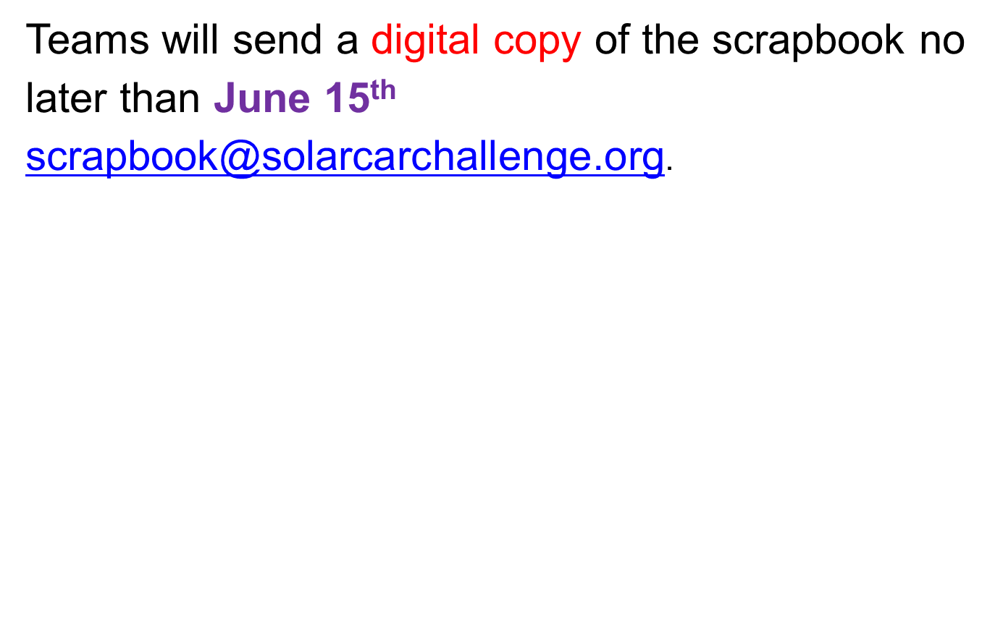

Slide 5
Oral Presentation
Teams will prepare a video presentation describing their solar car project.
This will be a single, unedited video of the team’s Oral Presentation.
The team will have up to 8 minutes to fully describe their project. Every team member must be a part of this oral presentation.

Slide 6
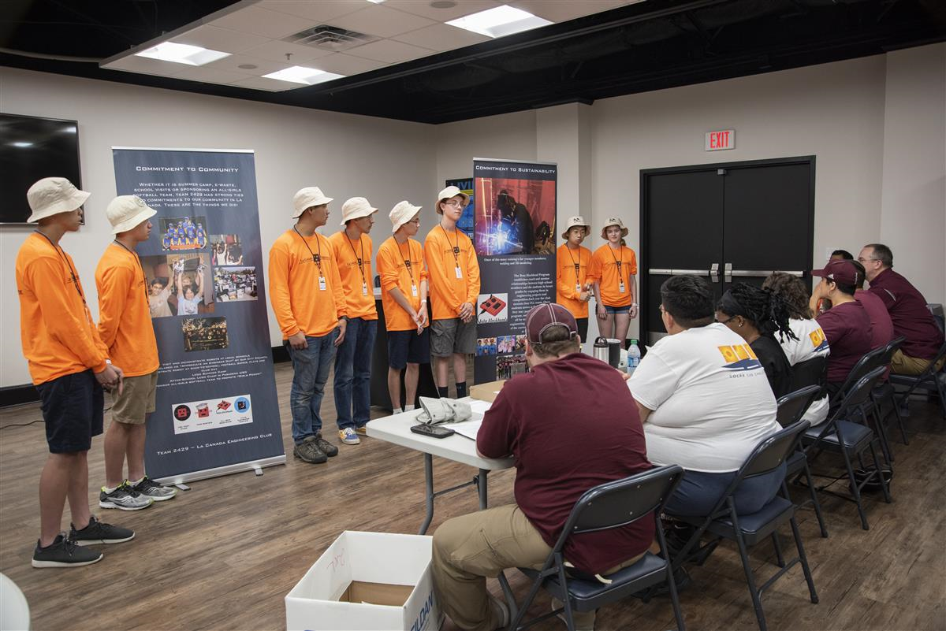
Teams will be awarded up to 20 “forever” miles based on the quality of their presentation.

Slide 7
Grading Criteria:
(a) Did the presentation give a full statement about the team’s project?
(b) Did team explain engineering decisions? For example, reasons for battery placement, array design, metal selection, body covering, etc.
(c) Did the team have documentation supporting their engineering decisions?

Slide 9
(d) Did all team members speak?
(e) Was the presentation well prepared and rehearsed.
(f) Was the team able to speak without the use of notes?
(g) Did the team use visual aids or use their solar car to explain engineering decisions?
(h) Did the team’s scrap book adequately support the team’s project?

Slide 10
PRESENTATION “TIPS”

Slide 11
(1) Everyone should stand with a similar posture.
(2) Everyone should keep their eyes on the person speaking. This helps focus the judges’ attention on what the speaker is saying. One set of “wandering eyes” detracts from the presentation.
(3) Take time to have the same clothes.
(4) Practice making your presentation to others so that everyone knows what they are going to say.

Slide 12
(6) Practice your presentation on other groups including parents, administration, and sponsors.
(7) Make sure your practice speaking slowly so that the judges can understand you.
(8) Don’t make rambling comments; choose your words carefully. You only have 8 minutes.
(9) Stand tall! Show a confident posture.

